Slide 1
BACH KHOA UNIVERSITY
FACULTY OF COMPUTER SCIENCE AND ENGINEERING
***
BIG DATA - FINAL REPORT
Mass Healthcare Analytic with
Distributed query engine & BI platform
INSTRUCTOR: PGS.TS Thoại Nam
BD01 GROUP: Nguyễn Minh Anh - 2370644
Trần Nguyễn Gia Hưng- 2370182
Nguyễn Bình - 2270754
26/12/2025

Slide 2
Contents:
Introduction
Technologies
Methodology
Implementation
Challenges
Result & Conclusion

Slide 3
Introduction

Slide 4



Context: Distributed Healthcare Data
Healthcare data is generated at scale across hospitals & clinics.
Analysts need cross-institution insights from distributed sources.
Traditional ETL → data warehouse is slow and costly.
Need fast SQL on distributed data without heavy data movement
Trino + Superset enable on-demand query & visualization.

Slide 5




Problems
Query data across networks of hospitals and get insight of:
Patient demographic. (*)
Health/disease trend. (*)
Treatment cost trend.
Organization-wide/Nationwide healthcare policy impact.
Notes:
“4 nhóm insight này là các bài toán ‘mass analytics’ vì đều cần truy vấn trên dữ liệu lớn và nhiều bệnh viện.”

Slide 6
Datasource Challenges Simulation
Datasource Incompatibility 🧩
Data Privacy Constraints 🔒
Schema drift (add/drop/rename columns)
Type/format variations (text vs numeric, datetime formats)
Coding differences (ICD-9/10, CPT, RxNorm)
Mask/remove PII, redact sensitive conditions
Missing/partial exports (NULLs, subset records)
Reduced location precision (geographic anonymization)
These challenges motivate the use of Trino’s schema-on-read and federated querying
Notes:
Phần trái – Datasource Incompatibility
Slide note:
Mô phỏng sự không đồng nhất schema giữa các bệnh viện.
Bao gồm: thêm/bớt/đổi tên cột, khác kiểu dữ liệu, khác chuẩn mã y tế.
Đây là tình huống rất phổ biến khi tích hợp dữ liệu liên viện.
Phần phải – Data Privacy Constraints
Slide note:
Mô phỏng các ràng buộc bảo mật dữ liệu y tế.
Một số node bị che thông tin cá nhân, thiếu dữ liệu hoặc giảm độ chính xác vị trí.
Giúp kiểm tra khả năng query trên dữ liệu không đầy đủ và bị ẩn thông tin.

Slide 7
2. Technologies

Slide 8

Technologies - Minio S3 Storage
S3-compatible object storage for storing multiple data layers.
Optimized for distributed analytics, enabling fast Parquet access by Trino.

Slide 9

Technologies - Trino (Fast distributed query)
Distributed SQL query engine for large-scale data analytics.
Query data in-place from data lakes & heterogeneous sources.
Supports federated queries across multiple nodes and systems.
Schema-on-read → no need data warehouse ingestion.
High performance via parallel, MPP execution.

Slide 10

Technologies - Apache Superset (Business Intelligence platform)
Apache Superset – BI & Visualization Platform:
Open-source, enterprise-grade BI platform.
Web-based data exploration & dashboarding.
Native SQL-based analytics on big data systems.
Suitable for large-scale healthcare analytics.

Slide 11
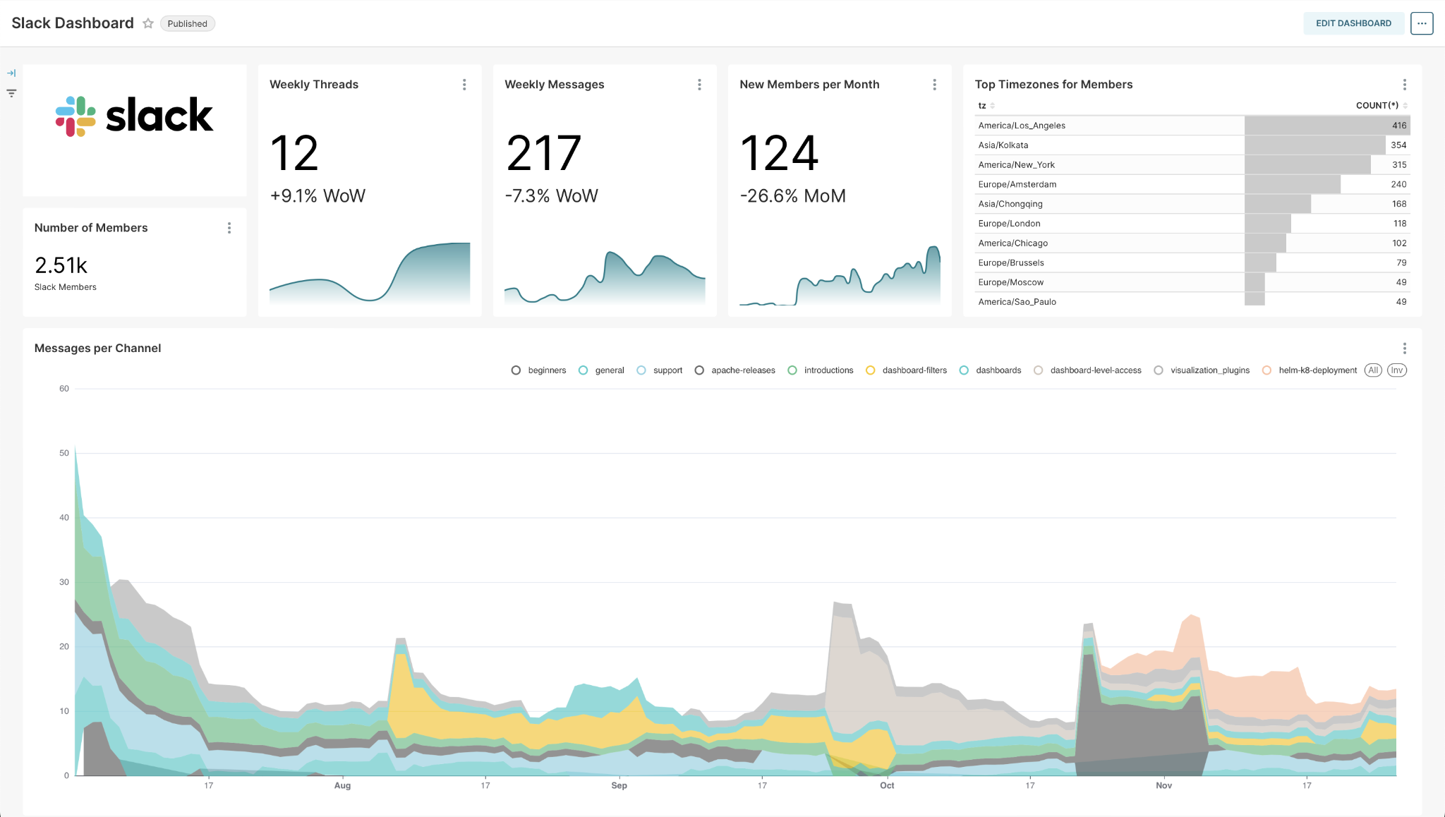
Figure 1: Apache Superset Dashboard Example

Slide 12
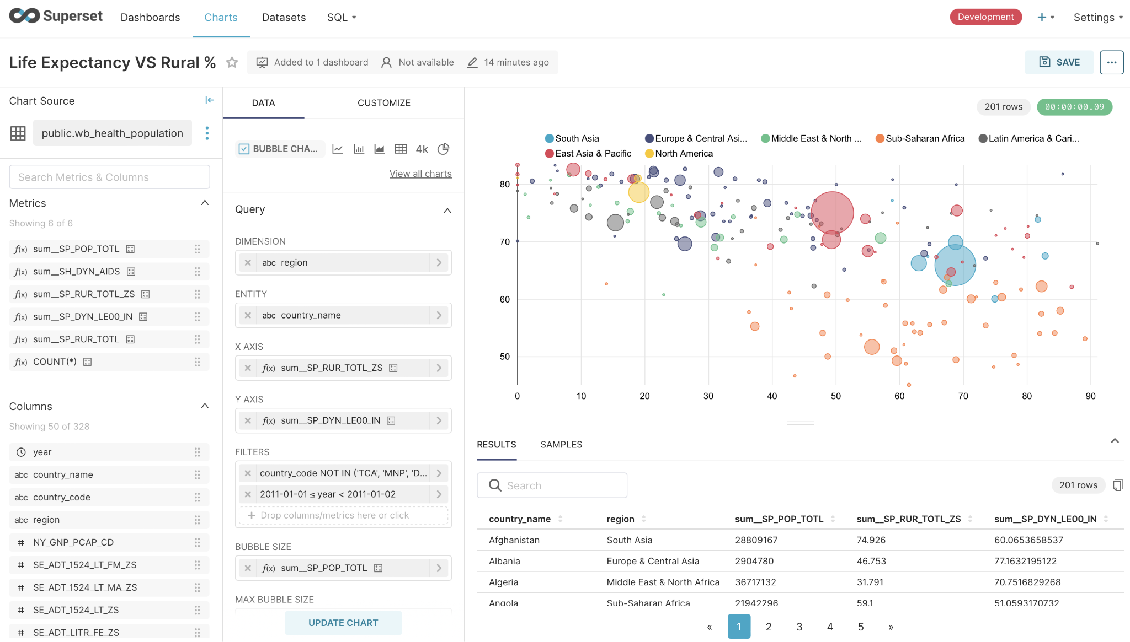
Figure 2: Apache Superset Chart Builder Feature

Slide 13
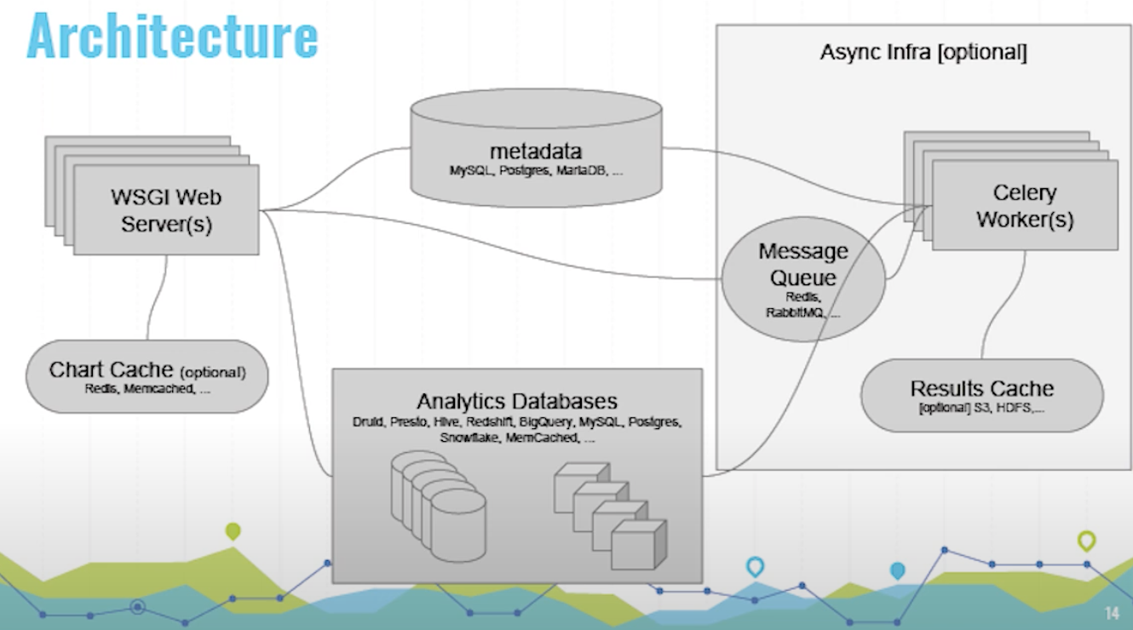
Apache Superset – Architecture
Figure 3: Apache Superset Flow Diagram

Slide 14
3. Methodology

Slide 15
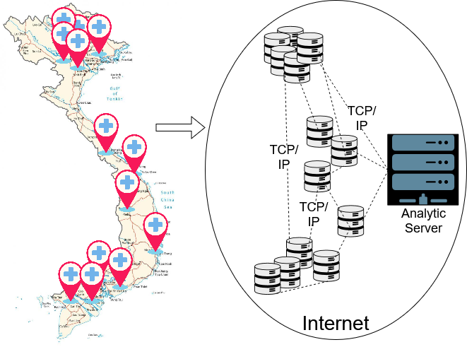
Distributed Sources → Central Data Lake
Data comes from multiple distributed hospitals.
Raw data is standardized to Parquet format.
All data is stored in a central MinIO data lake.
Figure 5: Hospital Network in Internet

Slide 16
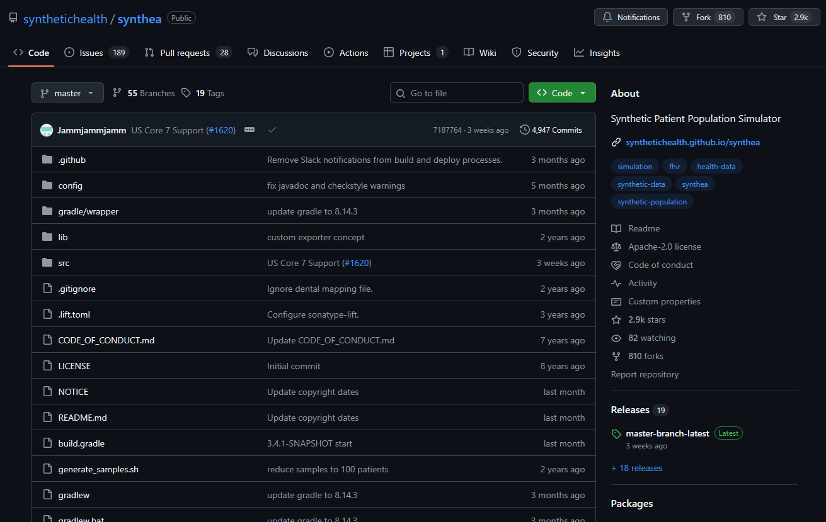
Experimental Data
Real patient-level data is rarely public due to privacy constraints.
Use Synthea Synthetic Patient Records (MITRE) as privacy-safe EHR-like data.
Figure 6 : Synthea Github page

Slide 17
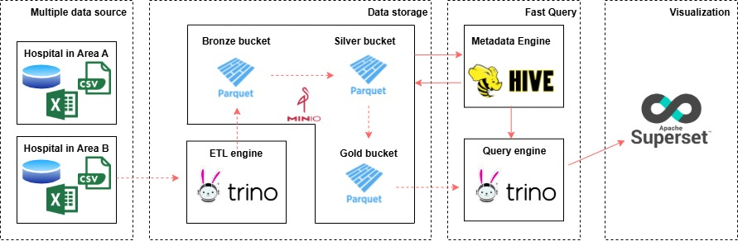
System Design
Sources → ETL (Parquet) → MinIO (Bronze/Silver/Gold) → Trino + Hive → Superset
Figure 4: System Flow Diagram

Slide 18
4. Implementation

Slide 19
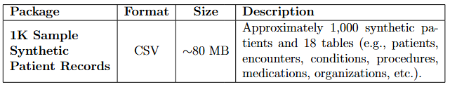
Implementation - Dataset/Datasource
Use Synthea Synthetic Patient Records (MITRE).
Selected package: 1K sample, CSV (~80MB), ~1,000 patients, 18 tables.
Figure 7: Selected Synthea dataset
Notes:
Vì dữ liệu bệnh nhân thật rất khó public do privacy, nên nhóm dùng synthetic EHR-like data để nghiên cứu/benchmark an toàn.
Dataset chọn: Synthea Synthetic Patient Records (MITRE).
Gói dùng trong project: 1K sample, định dạng CSV, ~80MB, khoảng 1,000 patients, 18 tables.
Dataset đủ nhẹ để xử lý nhưng vẫn đủ thông tin để chia node và chạy phân tích bằng Trino/Superset.

Slide 20
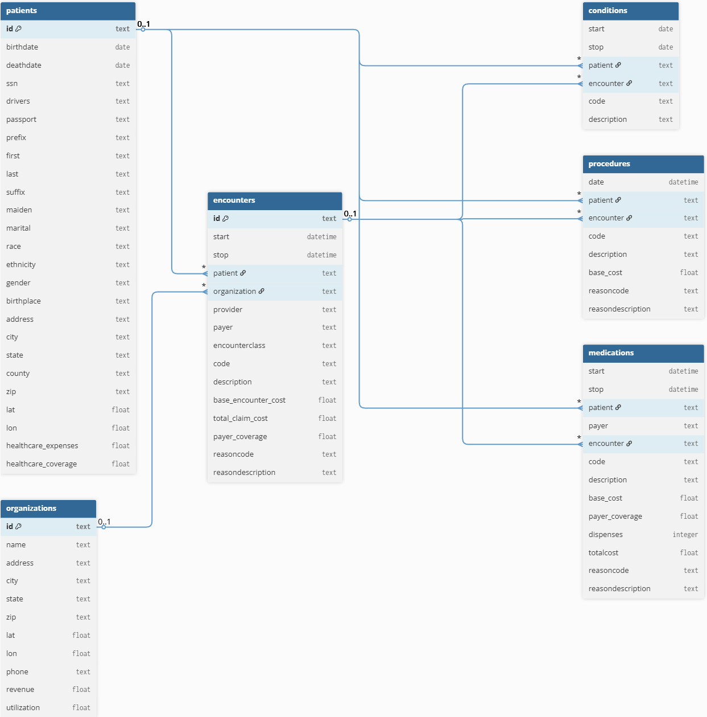
Core Schema (6 tables)
patients
encounters
conditions
procedures
medications
organizations.
Figure 8: Logical schema of 6 tables
Notes:
Từ Synthea, nhóm chọn 6 bảng core để mô tả đầy đủ hành trình bệnh nhân.
Schema bao phủ: patient → encounter(lần khám) → condition(bệnh lý) / procedure(thủ thuật) / medication(thuốc), kèm thông tin tổ chức organizations.
Thiết kế gọn nhưng đủ để phân tích demographic, disease trend và cost

Slide 21
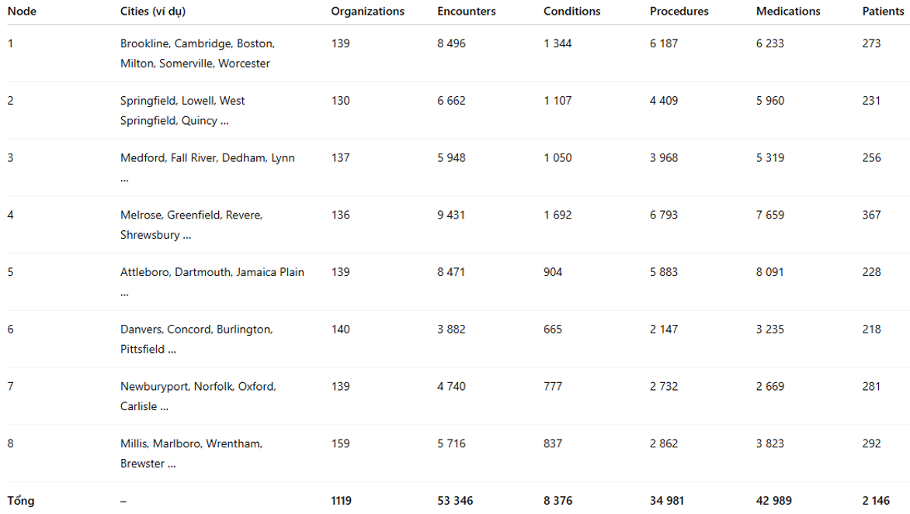
Multi-node Data Architecture (8 hospital nodes)
Figure 9: Data distribution across the eight nodes
Notes:
Dataset được chia thành 8 node, mỗi node mô phỏng một cụm bệnh viện độc lập.
Chia theo organization-centric, đảm bảo dữ liệu liên quan nằm cùng node.
Số lượng bản ghi giữa các node khác nhau, phản ánh quy mô bệnh viện không đồng đều.

Slide 22
Challenge: Healthcare Data Privacy
Privacy Regulations
Implemented Solutions
Healthcare data is subject to strict privacy regulations including HIPAA.
This constraint required alternative approaches to maintain realistic characteristics of data.
Synthesized datasets mimicking real-world healthcare data distributions and relationships.
Hash-based anonymization techniques applied in Silver layer to protect identifiable information.

Slide 23

Challenge: Distributed Query Performance
CHALLENGE
01
02
Direct Silver-Layer Queries
Network Overhead
Trino executes joins and aggregations over large fact tables in distributed environment
Coordination across multiple nodes introduces latency when processing complex analytical queries
Gold-Layer Solution
Pre-aggregated data marts reduce query complexity and improve dashboard response times

Slide 24
Implementation: Trino (Fast distributed query)
Technology Stack
Architecture Pattern
Analytics Focus
Trino distributed SQL query engine processes healthcare data across multiple layers with high performance and flexibility
Bronze–Silver–Gold layered approach ensures data quality progression from raw ingestion to analytics-ready marts
Pre-aggregated Gold-layer data marts optimize dashboard performance and enable interactive healthcare analytics

Slide 25
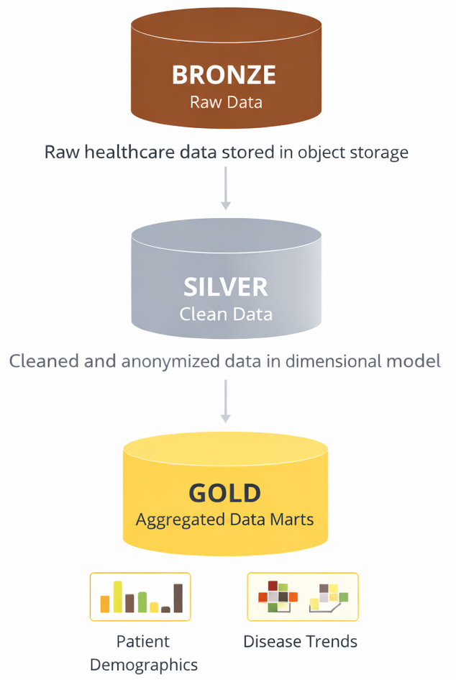
The Bronze–Silver–Gold Architecture
Data Layer Progression
Bronze Layer: Raw data ingestion from heterogeneous healthcare sources with minimal transformation
Silver Layer: Cleansed, validated, and anonymized data with standardized schemas and privacy controls
Gold Layer: Pre-aggregated analytical data marts optimized for specific use cases and query patterns
Figure 10: 3 layers of data

Slide 26
The Bronze–Silver–Gold Architecture
Dimension Tables (DIM) | Fact Tables (FACT)
minio.silver.dim_patient | minio.silver.fact_encounter
minio.silver.dim_organization | minio.silver.fact_condition
minio.silver.dim_date | minio.silver.fact_procedure
minio.silver.dim_condition_code | minio.silver.fact_medication
minio.silver.dim_procedure_code
minio.silver.dim_medication_code
Figure 10: 3 layers of data

Slide 27
The Bronze–Silver–Gold Architecture
Gold_mart_1 | Gold_mart_2
minio.gold.mart_patient_demographic | minio.gold.mart_disease_trend_monthly
Figure 10: 3 layers of data

Slide 28
Operational Complexity in Multi-Node Deployment
Object Storage Integration
Metadata Management
Configuring Trino connectors to efficiently access healthcare data stored across distributed object storage systems like S3 or HDFS
Maintaining consistent metadata catalogs and schema registries across multiple Trino coordinator and worker nodes
Secure Communication
Resource Orchestration
Implementing TLS encryption and authentication protocols for network traffic between distributed query processing nodes
Balancing compute resources and managing memory allocation across worker nodes to prevent bottlenecks during complex analytical queries

Slide 29
System Design
Sources → ETL (Parquet) → MinIO (Bronze/Silver/Gold) → Trino + Hive → Superset
Figure 11: System Flow Diagram

Slide 30
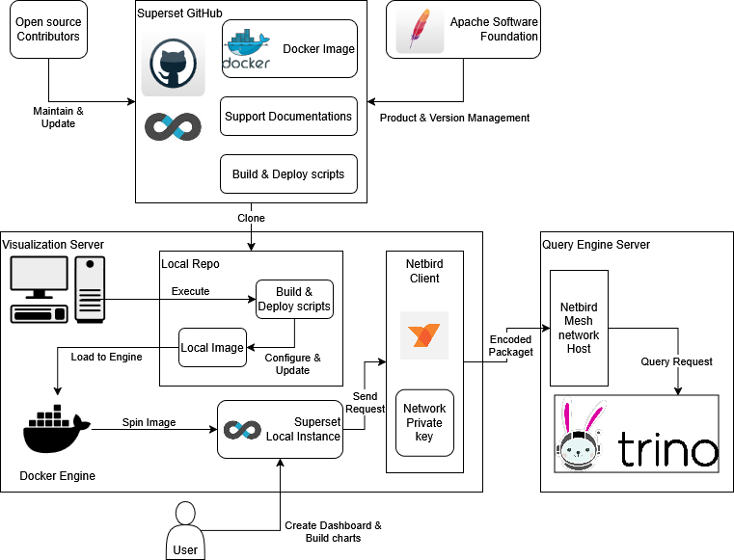
Implementation - BI Platform - Apache Superset
Figure 12 : Superset Implementation in local machine
Notes:
Vì dữ liệu bệnh nhân thật rất khó public do privacy, nên nhóm dùng synthetic EHR-like data để nghiên cứu/benchmark an toàn.
Dataset chọn: Synthea Synthetic Patient Records (MITRE).
Gói dùng trong project: 1K sample, định dạng CSV, ~80MB, khoảng 1,000 patients, 18 tables.
Dataset đủ nhẹ để xử lý nhưng vẫn đủ thông tin để chia node và chạy phân tích bằng Trino/Superset.

Slide 31
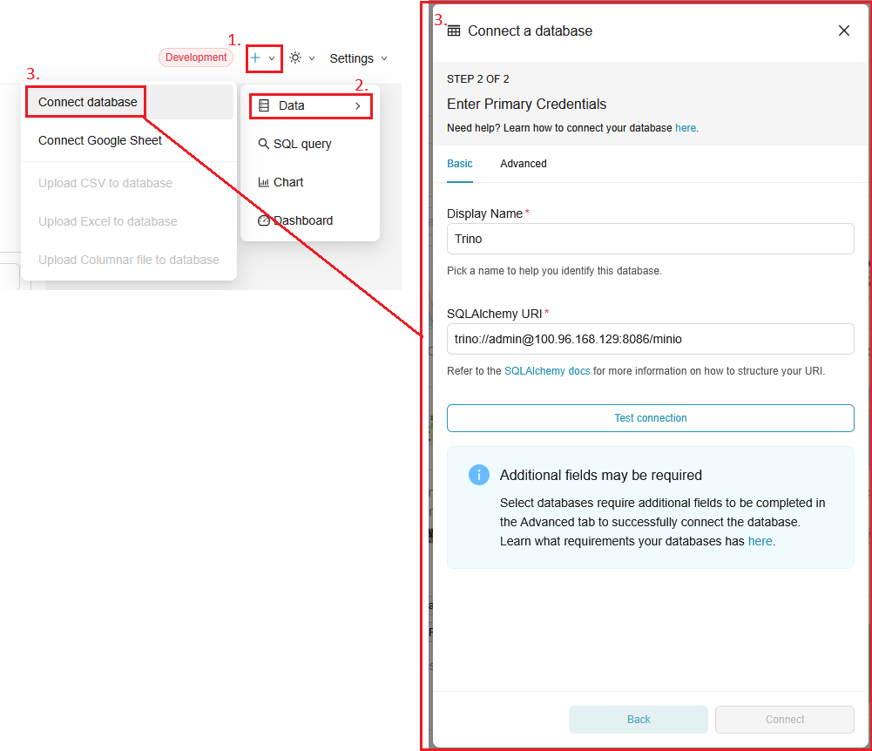
Implementation - BI Platform - Apache Superset
Figure 13 : Superset Database connection UI with Trino connection string
Notes:
Vì dữ liệu bệnh nhân thật rất khó public do privacy, nên nhóm dùng synthetic EHR-like data để nghiên cứu/benchmark an toàn.
Dataset chọn: Synthea Synthetic Patient Records (MITRE).
Gói dùng trong project: 1K sample, định dạng CSV, ~80MB, khoảng 1,000 patients, 18 tables.
Dataset đủ nhẹ để xử lý nhưng vẫn đủ thông tin để chia node và chạy phân tích bằng Trino/Superset.

Slide 32
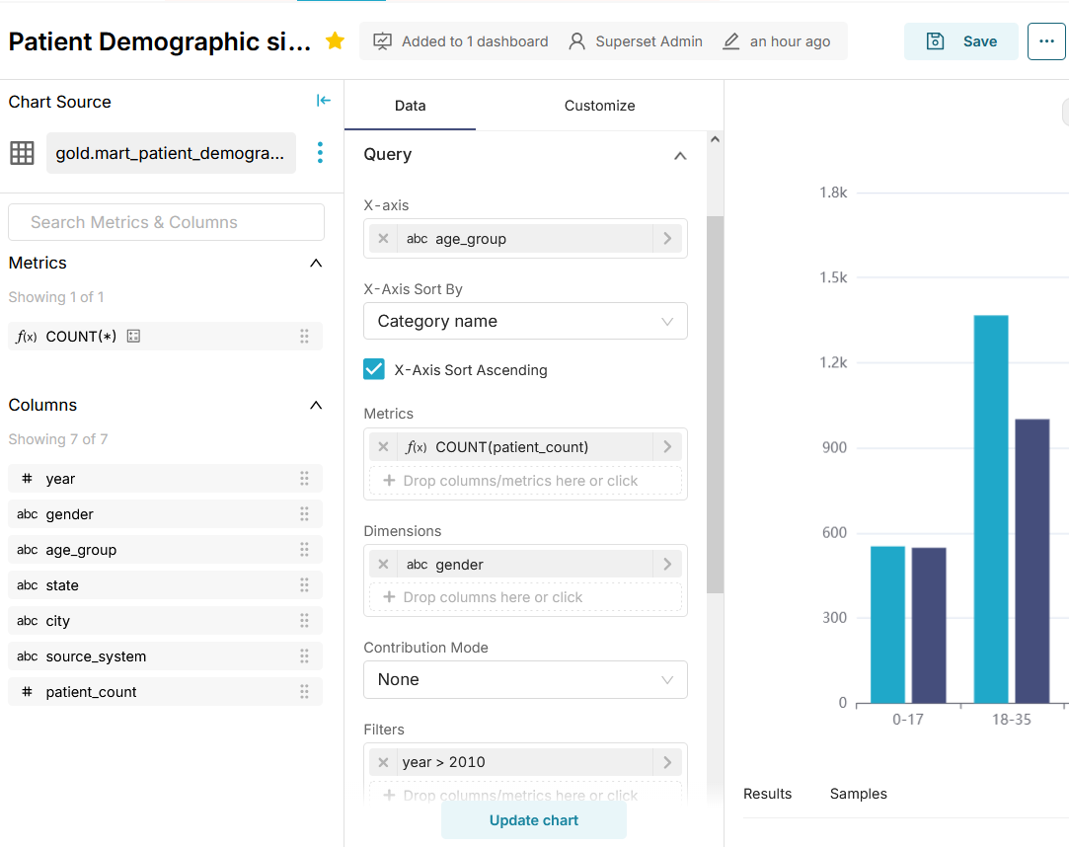
Dashboard Creation - Apache Superset
Figure 14 : Cluster Bar chart builder using dataset from Patient Demographic
Notes:
Vì dữ liệu bệnh nhân thật rất khó public do privacy, nên nhóm dùng synthetic EHR-like data để nghiên cứu/benchmark an toàn.
Dataset chọn: Synthea Synthetic Patient Records (MITRE).
Gói dùng trong project: 1K sample, định dạng CSV, ~80MB, khoảng 1,000 patients, 18 tables.
Dataset đủ nhẹ để xử lý nhưng vẫn đủ thông tin để chia node và chạy phân tích bằng Trino/Superset.

Slide 33
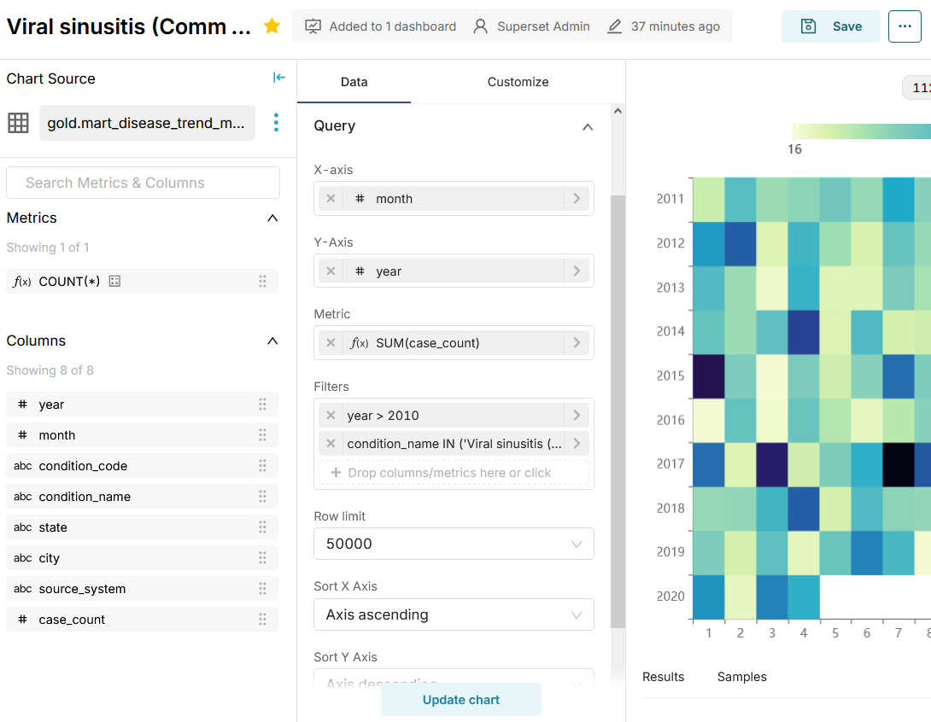
Dashboard Creation - Apache Superset
Figure 15 : Heatmap chart builder using dataset from Disease Trend
Analysis data mart
Notes:
Vì dữ liệu bệnh nhân thật rất khó public do privacy, nên nhóm dùng synthetic EHR-like data để nghiên cứu/benchmark an toàn.
Dataset chọn: Synthea Synthetic Patient Records (MITRE).
Gói dùng trong project: 1K sample, định dạng CSV, ~80MB, khoảng 1,000 patients, 18 tables.
Dataset đủ nhẹ để xử lý nhưng vẫn đủ thông tin để chia node và chạy phân tích bằng Trino/Superset.

Slide 34
6. Result & Conclusion

Slide 35

Figure 17: Superset demo

Slide 36
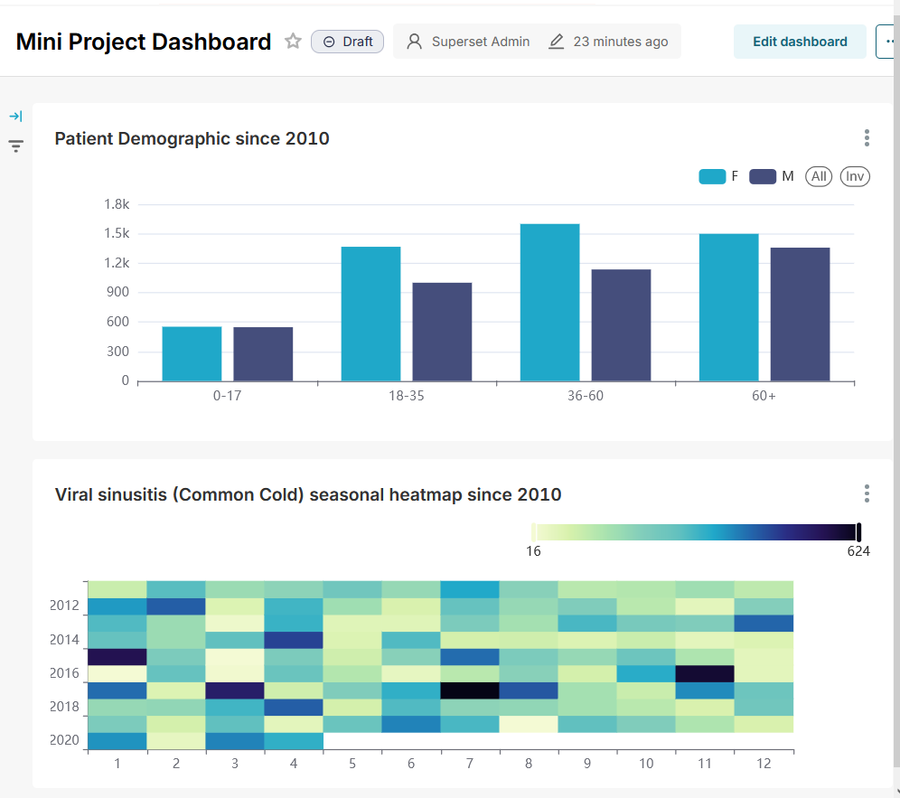
Result
Dashboard Visualization:
Cluster Bar Chart: patient demographics by age & gender
Seasonal Heatmap: common cold trends by month/year
Figure 18: Dashboard result

Slide 37

Technical Implementation Results
3
~4s
100%
Architecture Layers
Query Time Avg.
Privacy Compliance
Bronze, Silver, and Gold provide clear separation of concerns from raw ingestion to analytics
Gold-layer data marts decreased average dashboard query response times compared to Silver-layer access
Synthesized datasets and anonymization techniques ensured full regulatory compliance throughout development

Slide 38
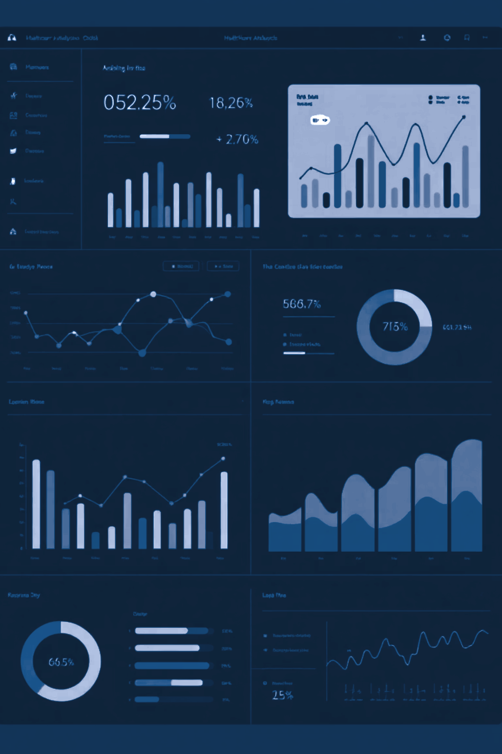



Gold-Layer Data Marts
Query Optimization
Performance Gains
Pre-computed aggregations eliminate repeated complex joins across distributed fact tables, reducing network overhead
Interactive dashboards and analytics queries execute significantly faster against purpose-built data marts
Use-Case Alignment
Data marts designed around specific analytical patterns and business requirements in healthcare domain

Slide 39
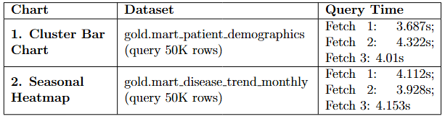
Result
Visualization Performance:
Figure 19: Visualization query performance table.

Slide 40
Result
Dataset and Data source:
Raw Synthea CSV (6 tables) → Partition into 8 Nodes → Schema & Privacy Simulation → Final Parquet Output.
Fast distributed query engine and Data marts:
System level: Trino supports fast, distributed SQL queries with independent scaling of compute and storage.
Analytics level: Data marts reduce query complexity and deliver reusable, privacy-preserving healthcare indicators.

Slide 41
Conclusion
Key Achievements:
Successfully implemented a distributed healthcare analytics system.
Trino enables fast federated queries & data mart generation
Apache Superset provides real-time visualization for decision support
System handles heterogeneous datasets from multiple hospital sources
Future Directions:
Develop automated ML-based schema semantic mapping
Expand datasource support via open-source Trino & Superset ecosystem

Slide 42
THANK YOU

